Slide 1
Online Shopping Project
itle

Slide 2

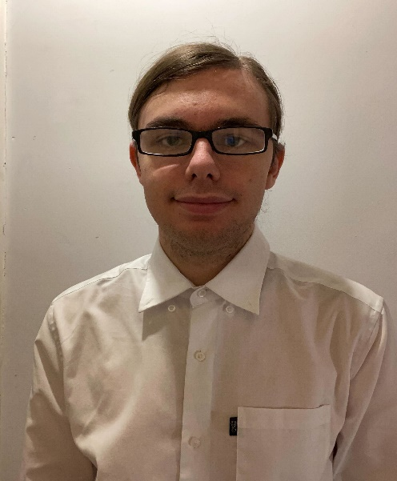
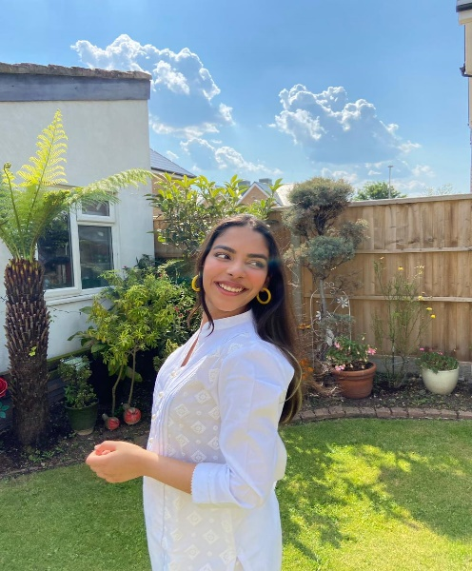
Meet the Team
Nosente Goll
Scrum Master
Front End Developer
Marley Curtis
Back End Developer
Noor Baakza
Front End Developer

Slide 3
Purpose
Notes:
The purpose of our project was to create a online shopping website, where the user is able to create a account and login in order to order the items that they would like.

Slide 4
LIFE CYCLE
Scrum Meetings
Roles and Tasks
Database Development
Presentation Planning
Sprint Lengths
Sprint lengths were a couple of hours
Road Blocks
Limitations and Extenuating circumstances

Slide 5
Development Tools
Front End
JavaScript
CSS
Back End
Java
Database
MySQL
PHP admin
Spring
JPA
Junit Testing

Slide 6
Back End Structure
The back end is organised using the MVC (Model, View and Controller) structure.
Repositories are used to access the database content.
Services is where the business logic for each entity takes place.

Slide 7
Add a Slide Title - 2

Slide 8
Add a Slide Title - 3

Slide 10
Add a Slide Title - 4

Slide 11
Add a Slide Title - 5

